Slide 1

Indian Government Dataset Analysis
Agriculture production of different food grains
Source: https://www.data.gov.in/
Dataset: Production – Department of Agriculture and Cooperation

Slide 2
Introduction
The dataset titled “Production – Department of Agriculture and Cooperation” contains agricultural production data
collected and maintained by the Indian Department of Agriculture. It primarily focuses on foodgrain production
across different agricultural seasons and years, giving valuable insights into trends, variations, and productivity over
time. This dataset can be used for agricultural analysis, forecasting, and policy evaluation.

Slide 3
Dataset Overview
Number of Rows: 429
Number of Columns: 25
Time Period Covered: 1993 – 2014 (March ending each year)
Main Columns:
Particulars: Describes the crop or category (e.g., Foodgrains, Kharif, Rabi).
Frequency: Indicates data reporting frequency (Annual, ending March of each year).
Unit: Measurement unit (e.g., million tons).
Year Columns: Represent annual production data (e.g., 3-1993, 3-1994, …, 3-2014).

Slide 4
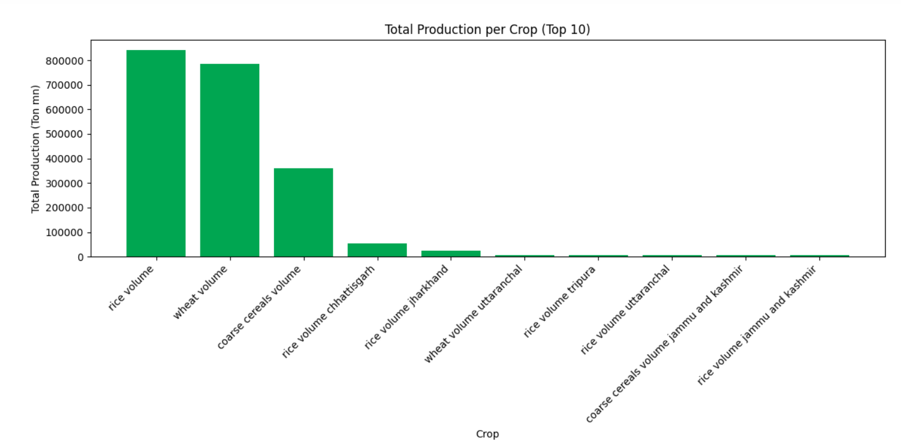
Production of each crop
Rice production is more comparing to other crops

Slide 5
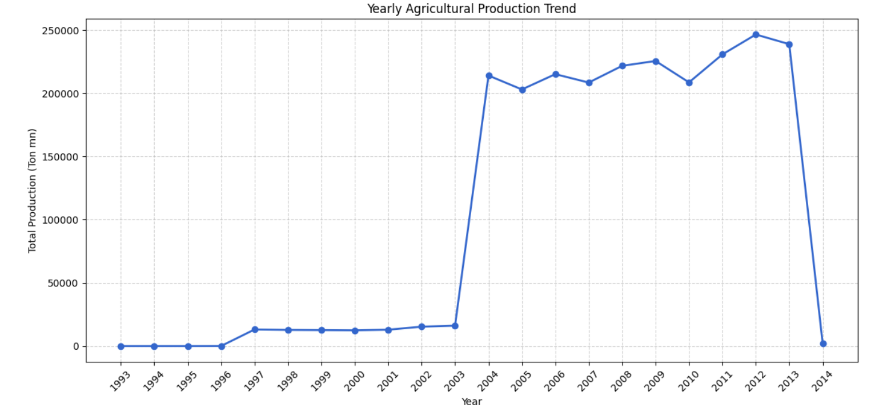
Yearly Agricultural Production
There is a sudden rise in 2003

Slide 6
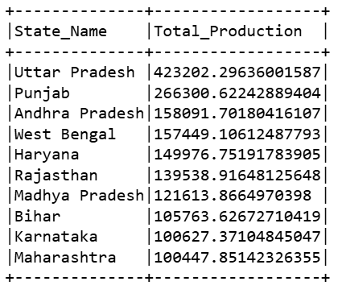
Production rate
Punjab is producting highest production rate

Slide 7
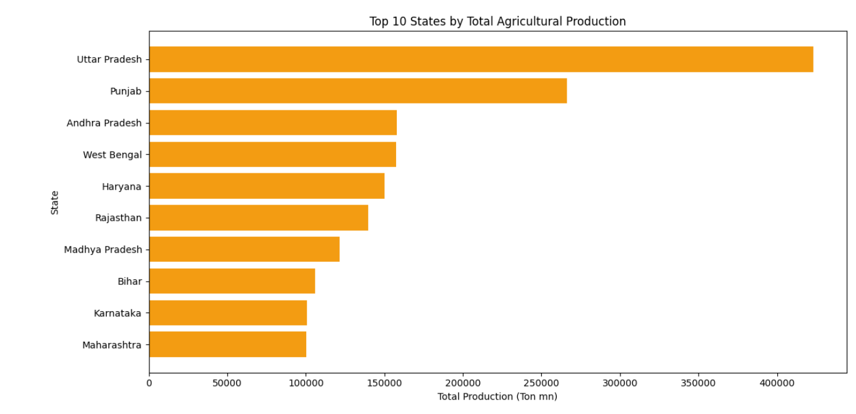
Total Agricultural Production

Slide 8
Dataset Observations
The dataset has 429 rows and 25 columns, covering agricultural production data from 1993 to 2014.
Key columns include Particulars, Frequency, Unit, and yearly production values.
Most data is measured in million tons (Ton mn) and recorded annually (ending March each year).
Missing values are common in early years (1993–2002) but data becomes more complete after 2004.
Foodgrain production shows a steady rise from around 198 million tons (2005) to 264 million tons (2014).
The dataset is useful for trend analysis, forecasting, and agricultural policy studies.

Slide 9
Conclusion
This dataset provides an extensive record of India’s agricultural production trends from 1993 to 2014, offering a strong
foundation for time-series analysis, production forecasting, and agricultural policy assessment. Despite missing values in
earlier years, it remains valuable for studying crop yield improvements and the impact of agricultural practices and
government initiatives on national foodgrain output.

